Slide 1
Optimization of vehicle routing problem using
artificial bee colony algorithm
Advisor
Zack Butler
Author
Nikhil Keswaney

Slide 2
Problem Statement
Capacitated vehicle routing problem(CVRP) is a combinatorial optimization problem which states as follows:
“ Find the optimal delivery routes for a set of vehicles to supply the set of customers with given demands minimizing the total cost of all the routes.”

Slide 3
Constraints
We have to find the optimal routes such that the following criterias are satisfied.
N customers with demand of d_{i}
There is a cost C_{ij} associated for going from i to j.
K trucks with capacity of Q.
Each customer should be visited exactly once.
Each truck should start and end at a depot.

Slide 4
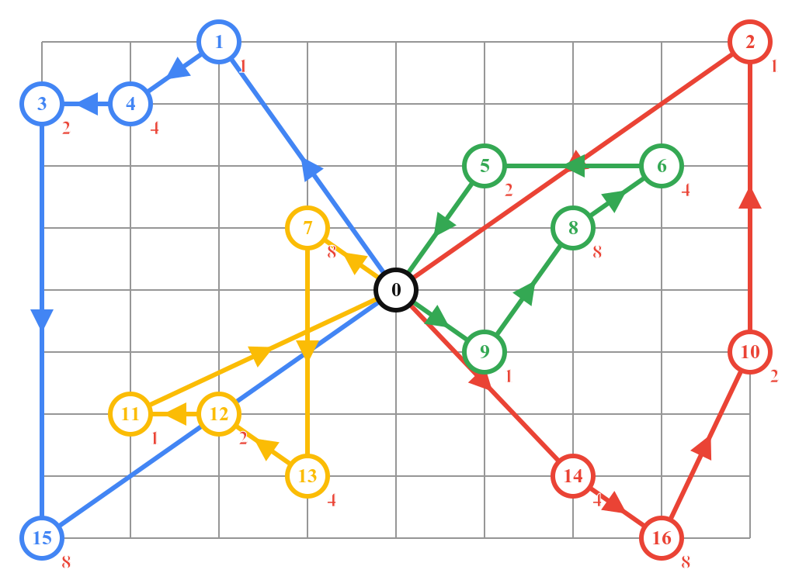
Example
Number of vehicles: 4
Vehicle Capacity: 45

Slide 5
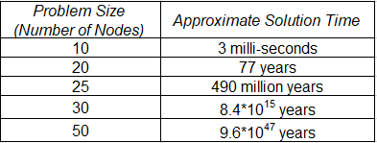
Computational Complexity
CVRP is an NP-hard problem
The brute force algorithm has a factorial growth rate for possible solutions. Assuming the processor used for enumeration does around ~1 bi/sec following is the time taken

Slide 6
Why solve CVRP?
In US transportation related goods and services contributes to around $1156 billion i.e. 11% of the GDP
Even a small percent of saving will yield a substantial saving
VRP not only contributes to saving the transportation cost but also helps in environment protection by reducing the fuel utilization

Slide 7
Ways to solve CVRP.
Exact algorithm
Finds the most optimal solution
Approximate algorithm
These technique doesn’t guarantee the optimal solution
Example: Hill climbing, simulated annealing, genetic algorithm, artificial bee colony algorithm … etc.

Slide 8
Artificial bee colony algorithm
Approximation algorithm
Foraging behaviour
The position of the food source represents a possible solution to the problem
The nectar amount represents the fitness of the solution.
The number of employed bees represents the number of solutions

Slide 9
Milestones
Milestone 1 ✔️
Finding dataset
Implementation of an exact algorithm
Milestone 2
Implement an approximate algorithm(Artificial bee colony algorithm)
Improve the performance of artificial bee colony algorithm
Milestone 3
Parallelize the artificial bee colony algorithm
Compare and contrast the run-time of all the implementations

Slide 10
Questions?

Slide 11
Thank you.

